Slide 1
Natural Language Processing
MSE_17_HN_TEAM_2
Ngô Anh Tuấn
Nguyễn Mạnh Cường
Hoàng Thái Sơn
Phạm Việt Dương
Final Project
Applications of NLP: fine tune model and case study
Teacher:
Assoc. Prof. Lê Hồng Phương

Slide 2
Agenda
Setup python environment
How to load NLP models of Hugging Face and testing model on local
Loading imdb dataset
Using imdb dataset to fine tune roberta
Inference new model

Slide 3
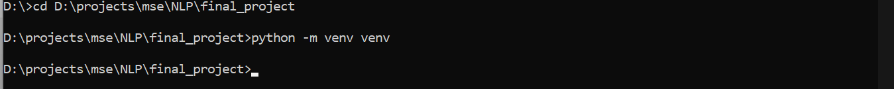
Install python https://www.python.org/downloads/
1. Setup python environment
Create new python environment
Active virtual environment

Slide 4
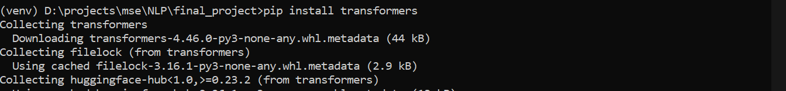
Install transformers library
Setup python environment
Install torch library

Slide 5
2. Loading model from hugging face
Step 1: Go to the model’s description page. In this example, our team is using xlm-roberta-base
Step 2: Use example code to loading model
from transformers import AutoTokenizer, AutoModelForMaskedLM
tokenizer = AutoTokenizer.from_pretrained('xlm-roberta-base')
model = AutoModelForMaskedLM.from_pretrained("xlm-roberta-base")
# prepare input
text = "Replace me by any text you'd like."
encoded_input = tokenizer(text, return_tensors='pt')
# forward pass
output = model(**encoded_input)

Slide 6
3. Loading imdb dataset
Imdb page : stanfordnlp/imdb
from datasets import load_dataset
dataset = load_dataset("stanfordnlp/imdb")
Loading dataset
from transformers import XLMRobertaTokenizer
# Load tokenizer
tokenizer = XLMRobertaTokenizer.from_pretrained("xlm-roberta-base")
# Tokenize function
def tokenize(batch):
return tokenizer(batch['text'], padding=True, truncation=True)
# Apply tokenization
tokenized_dataset = dataset.map(tokenize, batched=True)
Mapping dataset to pretrain data

Slide 7
4. Using imdb dataset to fine tune roberta
Class to fine tune: torch, XLMRobertaForSequenceClassification, Trainer, TrainingArguments
import torch
from transformers import XLMRobertaForSequenceClassification, Trainer, TrainingArguments
Convert data to PyTorch
# Load model
model = XLMRobertaForSequenceClassification.from_pretrained("xlm-roberta-base", num_labels=2)
# Convert datasets to PyTorch tensors
tokenized_dataset = tokenized_dataset.map(lambda x: {'labels': x['label']}, batched=True)
tokenized_dataset.set_format(type='torch', columns=['input_ids', 'attention_mask', 'labels'])

Slide 8
Fine tune: Initialization arguments
Initialization arguments
# Thiết lập training arguments với các tối ưu
training_args = TrainingArguments(
output_dir="./results",
learning_rate=3e-5, # Tăng learning rate
per_device_train_batch_size=32, # Tăng batch size
per_device_eval_batch_size=32,
num_train_epochs=2,
weight_decay=0.01,
evaluation_strategy="steps",
eval_steps=100, # Đánh giá thường xuyên hơn
save_strategy="steps",
save_steps=100,
load_best_model_at_end=True,
push_to_hub=False,
fp16=True, # Bật mixed precision training
gradient_accumulation_steps=4, # Thêm gradient accumulation
warmup_ratio=0.1, # Thêm learning rate warmup
dataloader_num_workers=4, # Tăng số worker cho DataLoader
gradient_checkpointing=True, # Bật gradient checkpointing để tiết kiệm bộ nhớ
report_to="none", # Tắt reporting để tăng tốc
)

Slide 9
Fine tune: Retraining
Retraining
if max_samples:
dataset["train"] = dataset["train"].shuffle(seed=42).select(range(max_samples))
dataset["test"] = dataset["test"].shuffle(seed=42).select(range(max_samples//10))
trainer = Trainer(
model=model,
args=training_args,
train_dataset=tokenized_datasets["train"],
eval_dataset=tokenized_datasets["test"],
tokenizer=tokenizer,
data_collator=data_collator,
compute_metrics=compute_metrics,
)
trainer.train()
"""
Đánh giá model sau khi train
"""
eval_results = trainer.evaluate()

Slide 10
Fine tune: Retraining and testing
Retraining
trainer = Trainer(
model=model,
args=training_args,
train_dataset=tokenized_datasets["train"],
eval_dataset=tokenized_datasets["test"],
tokenizer=tokenizer,
data_collator=data_collator,
compute_metrics=compute_metrics,
)
trainer.train()
# Lưu model sau khi retrain
output_dir = "./imdb-xlm-roberta"
model.save_pretrained(output_dir)
tokenizer.save_pretrained(output_dir)
#Đánh giá model sau khi train
eval_results = trainer.evaluate()

Slide 11
5. Inference new model
Loading
from transformers import XLMRobertaTokenizer, XLMRobertaForSequenceClassification
import torch
def load_model(model_path="./imdb-xlm-roberta"):
"""
Load model và tokenizer đã lưu
"""
try:
# Load tokenizer và model
tokenizer = XLMRobertaTokenizer.from_pretrained(model_path)
model = XLMRobertaForSequenceClassification.from_pretrained(model_path)
print(f"Đã load model thành công từ {model_path}")
return model, tokenizer
except Exception as e:
print(f"Lỗi khi load model: {str(e)}")
return None, None
Testing code
# Test vớ một số ví dụ
test_texts = [
"This movie was absolutely fantastic! I loved every minute of it.",
"What a terrible waste of time. I wouldn't recommend this to anyone."
]
print("\nTest dự đoán với một số ví dụ:")
for text in test_texts:
result = predict_sentiment(text, model, tokenizer)
print(f"\nText: {result['text']}")
print(f"Sentiment: {result['sentiment']}")
print(f"Confidence: {result['confidence']:.4f}")

Slide 12
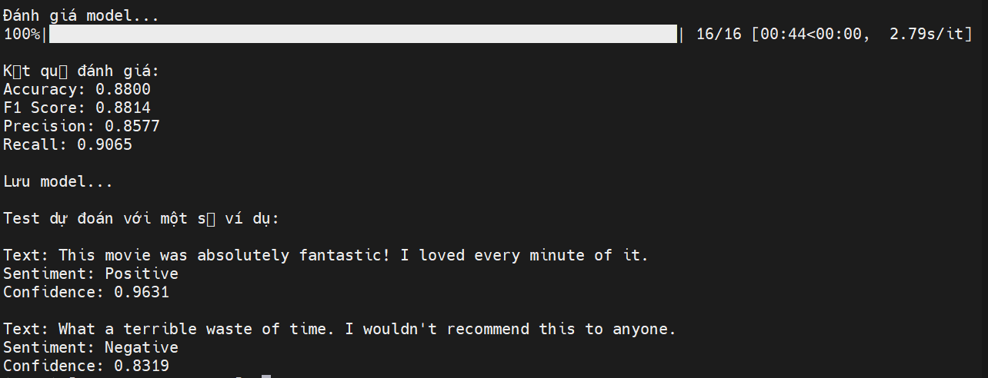
Inference new model
Testing result

Slide 13
Using squad dataset fine tune Roberta model for Question and Answer
Stanford Question Answering Dataset (SQuAD) is a reading comprehension dataset, consisting of questions posed by crowdworkers on a set of Wikipedia articles, where the answer to every question is a segment of text, or span, from the corresponding reading passage, or the question might be unanswerable.
SQuAD 1.1 contains 100,000+ question-answer pairs on 500+ articles

Slide 14
Model Fsoft-AIC/videberta-base
ViDeBERTa, a new pre-trained monolingual language model for Vietnamese, with three versions - ViDeBERTa_xsmall, ViDeBERTa_base, and ViDeBERTa_large, which are pre-trained on 138GB of Vietnamese text of high-quality and diverse Vietnamese text using DeBERTaV3 architecture.

Slide 15
Resources
Github link: https://github.com/ngotuan12/nlp_final_project Presentation: main/Natural Language Processing.pptx
Roberta and imdb code: imdb-roberta-fine-tune.py, imdb-roberta-base-testing.py, imdb-roberta-testing.py
Roberta and squad code: qa-xlm-roberta-fine-tune.py, qa-xlm-roberta-base-testing.py, qa-xlm-roberta-testing.py
After fine tune model pretrain data: https://drive.google.com/drive/folders/1l6yGdbADwpgKOurTWLU7umd9-ZeRCtne?usp=sharing

Slide 16
Thank you
MSE_17_HN_TEAM_2

